Slide 1

Names
Ashfaq Ahmad
Afaq Ahmad
Uswa sajid
Reg numbers
19pwcse1795
19pwcse1803
19pwcse1773
Section B

Slide 2

GROUP
SECTION B

Slide 3

DO NOW!
WHAT IS TERRORISM?

Slide 4
TERRORISM
DEFINITION
THE USE OF VIOLENCE OR A THREAT OF VIOLENCE TO ACHIEVE A POLITICAL GOAL.
TERRORISM IS NOT A UNIQUELY MIDDLE EASTERN OR ISLAMIC PHENOMENON.
IT IS NOT A NEW CREATION.

Slide 5

Change Or Overthrow A Government
Gain Independence
Seek Justice For A Wronged Group
Obtain Concessions From A Government
Get National Or International Attention

Slide 6

Civil
Political
Non political
Official or state terrorism
Religious terrorism

Slide 7
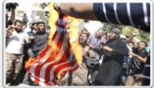
CIVIL disorder:
A form of collective violence interfering with the peace, security and normal functioning of community
Political terrorism:
To create fear in community for political purpose.
Non political terrorism:
Terrorism that is not aimed at political purposes but to create and maintain a high degree of fear for the purpose to gain individual or collective achievement rather than the political objective.

Slide 8
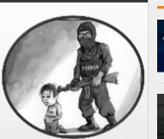
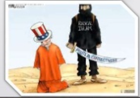
Official or state terrorism:
Referring to nations whose rule is based upon fear and
oppression
Religious terrorism:
Terrorist acts throughout history have been performes on
religious grounds with goal to either spread or enforce a
system a system of belief , viewpoint or opinion.

Slide 9


Slide 10
MAJOR INCIDENT
SWAT and FATA operations
Killing of Baitullah Mahsud
Kerry Lugar Bill
Anti Americanism
Pak-China joint anti-terrorism drill
Wen Jiabao visit of Pakistan
Arrest of Abdul Ghani Baradar
Raymond Davis Case
Osama bin Ladin Gunned down in Abbottabad
Memo-gate Scandal
Salalah Incident
Disqualification of Yousaf Raza Gillani
Malala Yousafzai was Shot
Pak-Iran Gas Pipeline
General Elections of Pakistan
Pak-China approved CPEC
PM visit of Washington DC

Slide 11
MODERN TERRORISM
The war on terror (WoT) also known as Global war on terrorism(GWOT)
U.S President George W. Bush first use “the term War on terror” on 20 sep 2001
In 2013 president Obama announced that the united state was no pursuing a war on terror, as a military focus should be on specific enemies rather than a tactic. He started”
In 2017 Donald Trump assumed presidency of the United States and vowed that the fight against ISIL is his number one priority

Slide 12
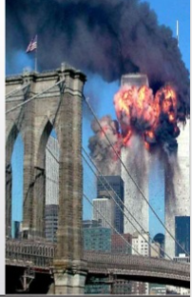
9/11 Incident
9/11 INCIDENT On the morning of September
11, 2001, 19 men affiliated with al-Qaeda
hijacked four airliners all bound for California
The hijackers intentionally crashed two airliners
into the Twin Towers of the World Trade Center
in New York City The hijackers crashed a third
airliner into the Pentagon in Arlington County,
Virginia, just outside Washington D.C. The fourth
plane crashed into a field near Shanks Ville,
Pennsylvania.

Slide 13
ORGANIZATION OF TERRORISM
AL-QAEDA
AQIM
AQAS
BOKO HARAM
ISIL
TALIBAN

Slide 14

AL- Qaeda:
Al-Qaeda meaning “The base”, “The foundation” or “The fundament” is a militant Sunni Islamist multi-national organinization founded in 1988 by Osama bin Laden, Abdullah Azzam and several other Arab volunteers who fought against the sovient invasion of afghanistan in the 1980s.
Leadership:
Osama bin Laden(1988-2011)
Ayman al- Zawahri(2011-present)

Slide 15

USAMA BIN LADEN
1957 -- Osama bin Muhammad bin Awad bin Laden is born in Riyadh, Saudi Arabia. He is the 17th of 54 children fathered by Muhammad Awad bin Laden, a Yemeni immigrant who built a billion-dollar construction company in Saudi Arabia. His mother is Hamida al-Attas, from Syria. 1979-- Bin Laden graduates from King Abdul Aziz University in Jeddah with a degree in public administration and economics. He goes to Afghanistan to join the "jihad," or "holy war," against the
Soviet Union. 1989 -- The Soviet Union withdraws from Afghanistan. Bin
Laden returns to Saudi Arabia to work for the family construction
firm, the Bin Laden Group. August 7, 1990 -- Following the Iraqi invasion of Kuwait, U.S. troops arrive in Saudi Arabia in order to
have a close base to eventually go after Iraqi leader Saddam
Hussein's troops. Bin Laden becomes outraged at the U.S.
forces' presence near the Muslim holy sites of Mecca and Medina USAMA BIN LADAN

Slide 16
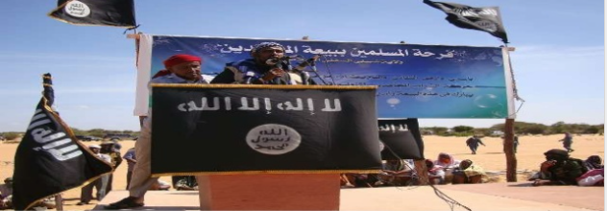
What they Want?
They believe that everyone should be a muslim and should live under islamic law. They believe their religion is the one true religion.

Slide 17
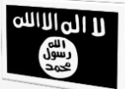
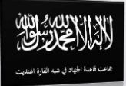
AQIM (Al Qaeda in Islamic Maghreb , Algerian )
AQAP (Al-Qaeda in the Arabian Peninsula , Yemen and Saudi Arabia , January 2009)
AQIS(al-Qaeda in the Indian Subcontinent , Pakistan,
India, Bangladesh , September 2014)

Slide 18
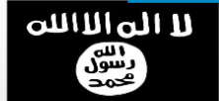
Islamic State of Iraq and the Levant(ISIL)
Known As…
"ISIL", "ISIS", "Daish", "Daesh", and "Islamic State group“
Is a militant Islamic group that follows a fundamentalist, Wahhabi doctrine of Sunni Islam. ISIL gained global prominence in early 2014 when it drove Iraqi government forces out of key cities in its Western Iraq offensive followed by its capture of Mosul.

Slide 19
Boko Haram
Boko Haram, referred to by themselves as al-Wilāyat al-Islāmiyya Gharb Afrīqiyyah (Arabic: ‫أفريقيا‬ ‫غرب‬ ‫اإلسالمية‬ ‫الوالية‬ ,( Islamic State West Africa Province, ISWAP) and Jamā'at Ahl as-Sunnah lid-Da'wah wa'l-Jihād (Arabic: ‫والجهاد‬ ‫للدعوة‬ ‫السنة‬ ‫أهل‬ ‫جماعة‬ ," Group of the People of Sunnah for Preaching and Jihad") is an Islamic extremist group based in northeastern Nigeria northern Cameroon. Leaders:
Abu Musab al-Barnawi (appointed by ISIL)
Abubakar Shekau
Mohammed Yusuf (founder)
The group had alleged links to al-Qaeda, but in March 2015, it announced its allegiance to the Islamic State of Iraq and the Levant (ISIL). Since the current insurgency started in 2009, it has killed 20,000 and displaced 2.3 million from their homes and was ranked as the world's deadliest terror group by the Global Terrorism Index in 2015.

Slide 20

TALIBAN
The Taliban ("students") which recently changed their name and identity to Islamic Emirate of Afghanistan (IEA) is a Sunni Islamic fundamentalist political movement in Afghanistan.
ERA
1994–1996 (militia)
1996–2001 (government)
2002–present (insurgency) Taliban

Slide 21

US (Leader)
UK
FRANCE
GERMANY
Begium
Romania
Spain
Turkey
Norway
ITLAY
PAKISTAN
AFGHANISTAN
IRAQ
SYRIA
Egypt
Libya
Yemen
Somalia
Lebanon
Nigeria
NETO PARTICIPENTS
NON NATO PARTICIPENTS

Slide 22
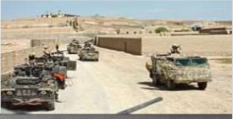
NATO ROLE
International Security Assistance Force: The British 16th Air Assault Brigade (later reinforced by Royal Marines) formed the core of the force in southern Afghanistan, along with troops and helicopters from Australia, Canada and the Netherlands. The initial force consisted of roughly 3,300 British, 2,000 Canadian, 1,400 from the Netherlands and 240 from Australia, along with special forces from Denmark and Estonia and small
contingents from other nations. The monthly supply
of cargo containers through
Pakistani route to ISAF in Afghanistan
is over 4,000 costing around 12 billion in
Pakistani Rupees.

Slide 23
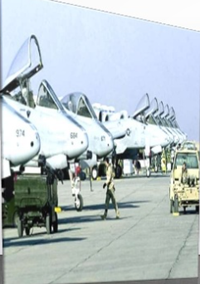
PAKISTAN
Pakistan Following the 11 September 2001 attacks, former President of Pakistan Pervez Musharraf sided with the U.S. against the Taliban government in Afghanistan after an ultimatum
by then U.S. President George W. Bush.
Musharraf agreed to give the U.S. the use
of three airbases for Operation Enduring
Freedom. In 2002, the Musharraf-led government
took a firm stand against the jihadi organizations
and groups promoting extremism, and arrested
Maulana Masood Azhar head of the Jaish-e-Mohammed
and Hafiz Muhammad Saeed chief of the Lashkar-e-Taiba
and took dozens of activists into custody. An official ban
was imposed on the groups on 12 January

Slide 24
Main Objective
The Saudi born Zayn al-Abidn Muhammed Hasayn Abu Zubaydah, was arrested by Pakistani officials during a series of joint U.S. and Pakistan raids during the week of 23 March 2002.
Later that year on 11 September 2002, Ramzi bin al-Shibh was arrested in Pakistan after a three-hour gunfight with police forces. Bin al-Shibh is known to have shared a room with Mohamed Atta in Hamburg, Germany and to be a financial backer of al-Qaeda operations
On 1 March 2003, Khalid Shaikh Mohammed was arrested during CIA-led raids on the suburb of Rawalpindi, nine miles outside of the Pakistani capital of Islamabad.

Slide 25
Casualties
Iraq Body Count project documented 110,937–121,227 civilian deaths from violence from March 2003 to December 2012. 4,409 U.S. military dead (929 non-hostile deaths), and 31,926 wounded in action during Operation Iraqi Freedom
Afghanistan: between 10,960 and 249,000.
Pakistan: Between 1467 and 2334 people were killed in U.S. drone attacks as of 6 May 2011. Tens of thousands have been killed by terrorist attacks, millions displaced.
Somalia: 7,000+
US: between 50,000 to 1,25,000

Slide 26
Expense
A March 2011 Congressional report estimated spending related to the war through the fiscal year 2011 at $1.2 trillion.
According to the Soufan Group in July 2015, the United States government spends $9.4 million per day in operations against ISIS in Syria and Iraq

Slide 27
CRITISISM ON GLOBAL WAR
Think about it....
The United States (U.S.) is at war with terror. Not with a country, not with a specific terrorist organization, but with terror. So technically, the U.S. is at war with every single terrorist and terrorist cell around the world. Terrorism will always exist. There will always be extremists ready to commit acts of terrorism for whatever reason they may have. If the U.S. remains in this war on terror, then the war will NEVER END
. Casualties: The war on terror launched by George W. Bush Jr. has led to the deaths of at least 227,000 people.

Slide 28
THANKYOU!!!!!!

